Slide 1
DrinkWorks
Enterprise Management and Entrepreneurship
2022
Mafalda Costa - up202109478@up.pt
Mariana Soares - up201605775@up.pt
Nuno Oliveira - up201806525@up.pt
Ricardo Cardoso - up201604686@up.pt
Tiago Araújo - up202109481@up.pt

Slide 2
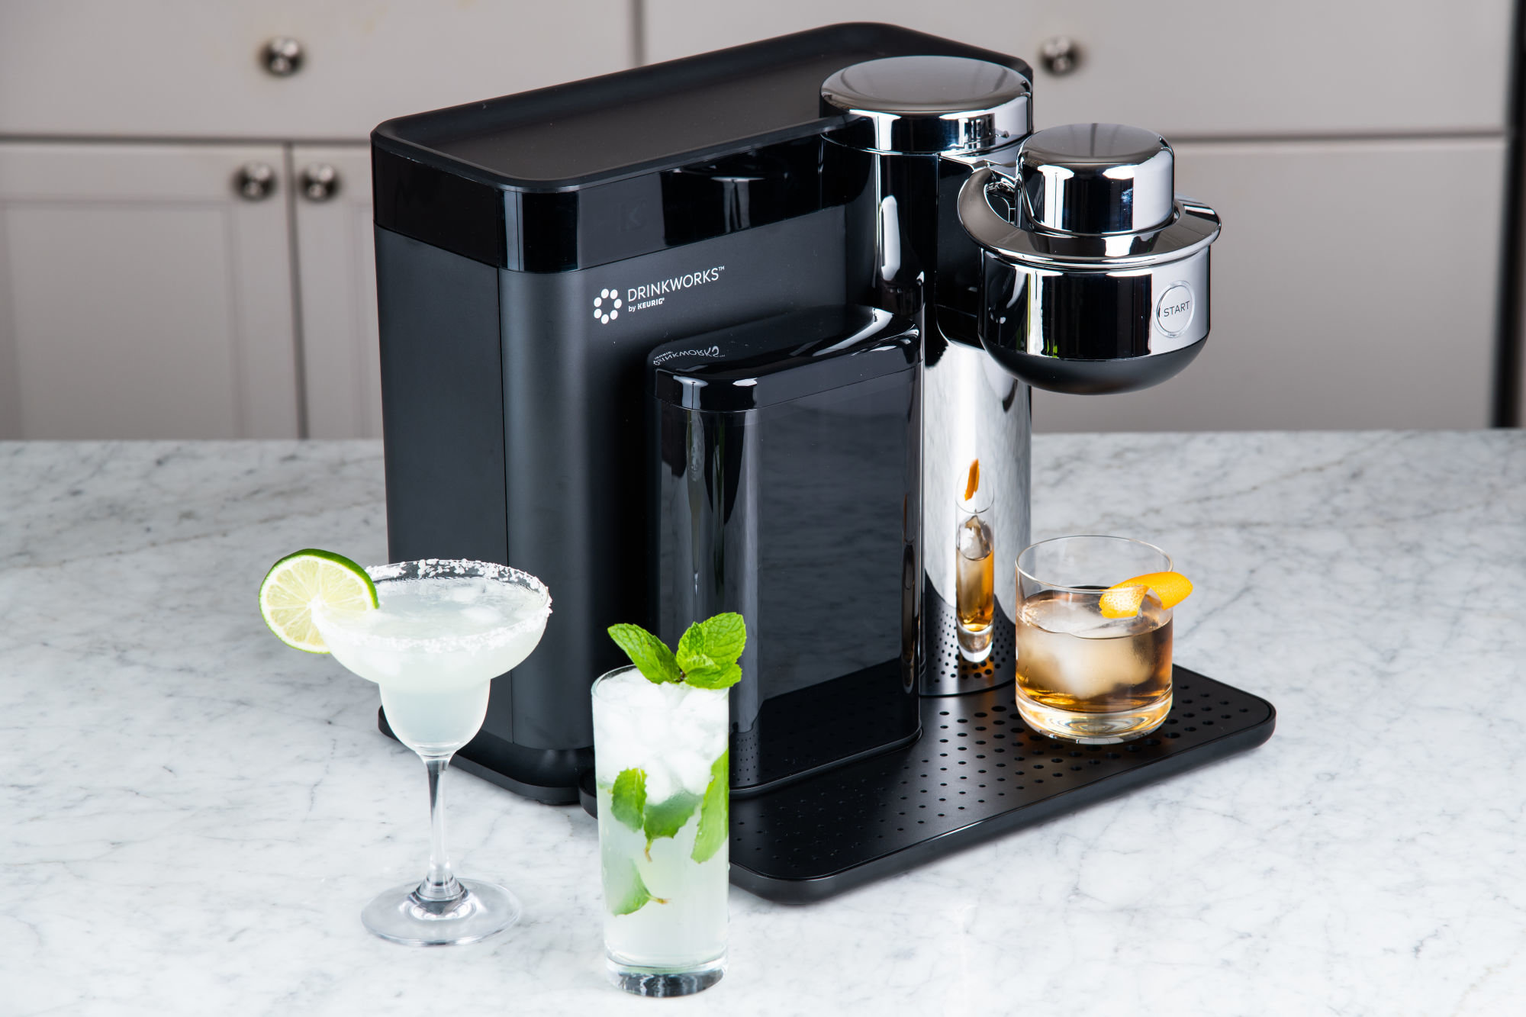
1. What problem is Drinkworks trying to solve?
People tend to drink fewer cocktails at home because of the additional preparation time compared to wine or beer.
Drinkworks solves this problem by offering a machine capable of preparing a cocktail in less than 1 minute just by inserting a pod and pressing one button.

Slide 3
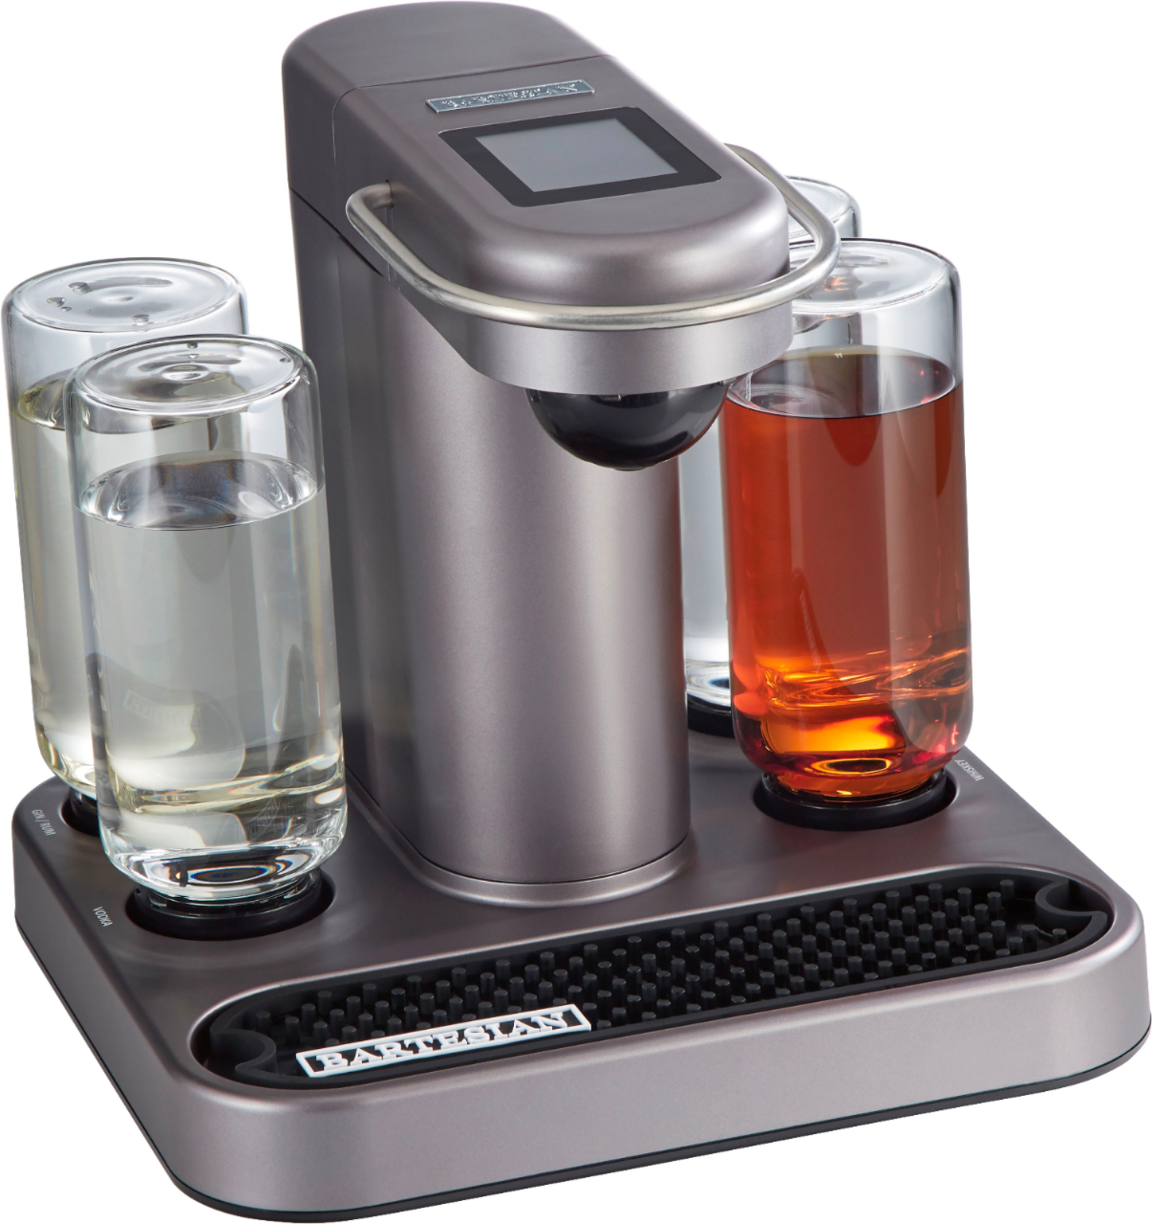
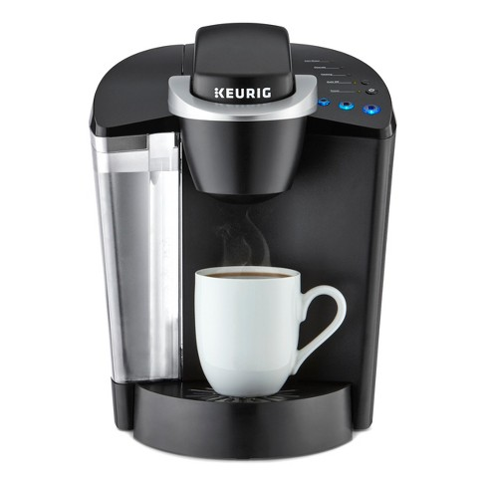
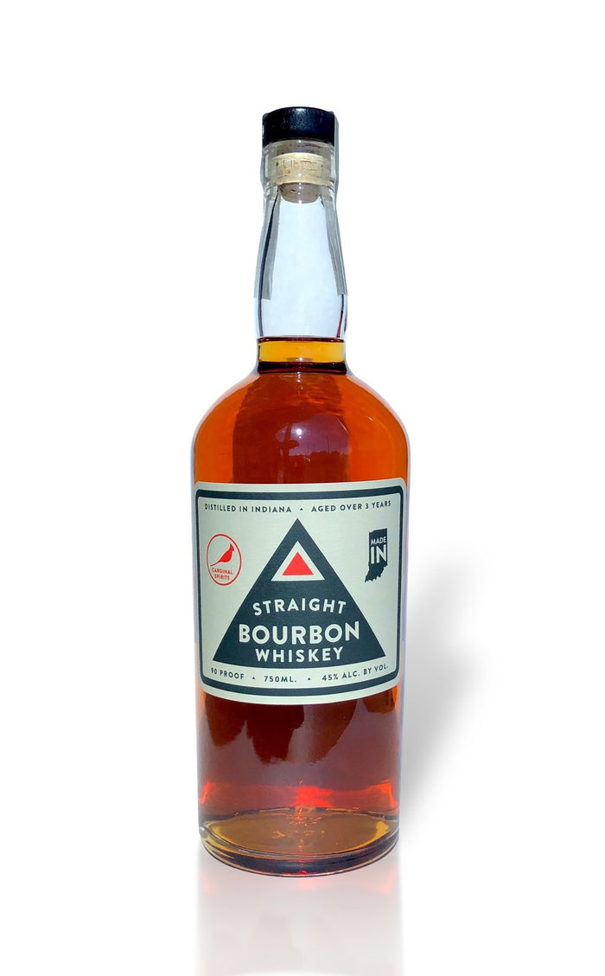
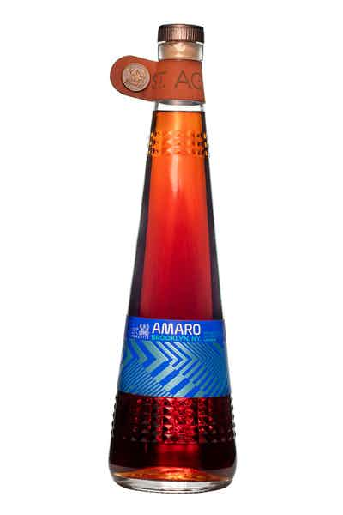
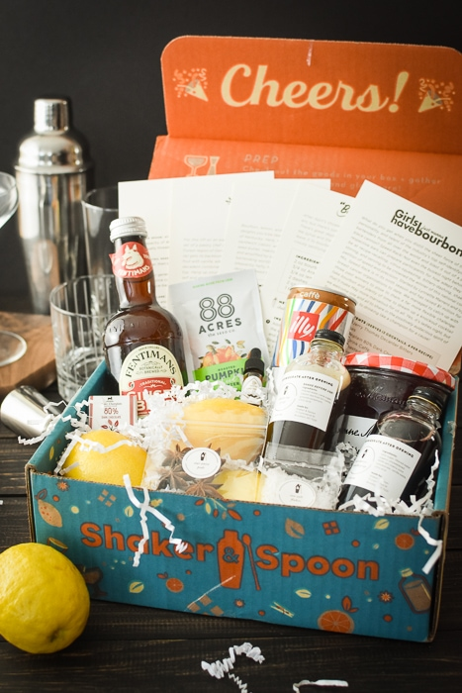
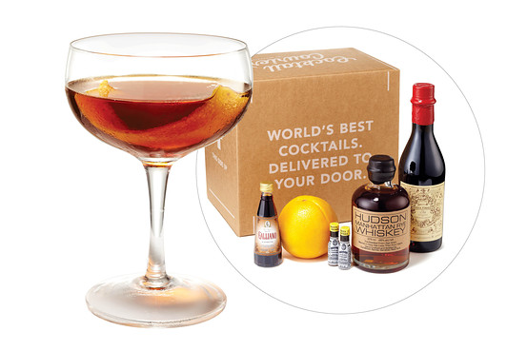
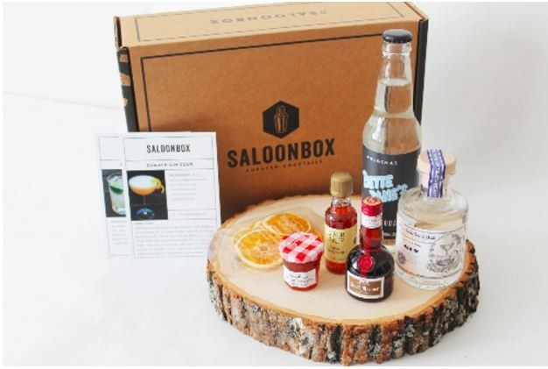
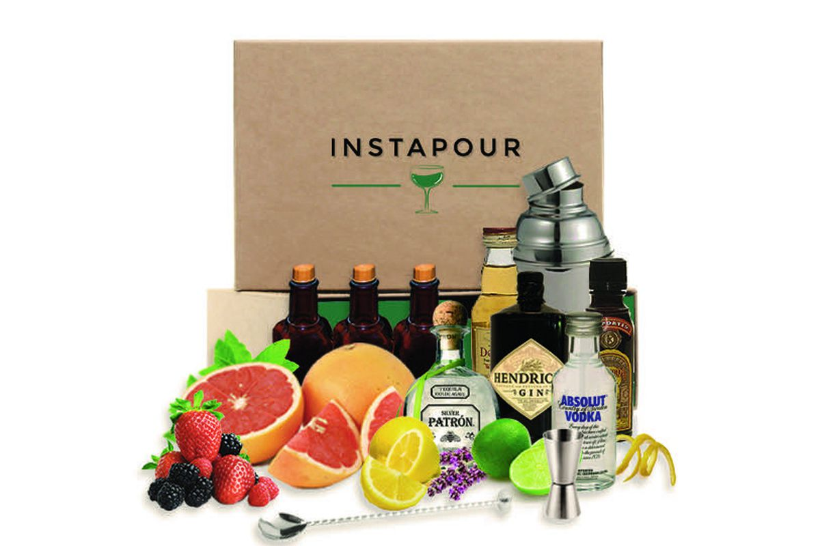
1. What is Drinkworks’ frame of reference?
Ready-to-drink cocktails in cans or bottles:
Cardinal Spirits
St. Agrestis
Cocktail-themed subscription boxes and cocktail-making kits:
Cocktail Courier
SaloonBox
Shaker & Spoon
Instapour
Other similar products:
Bartesian
Keurig’s coffee machines
Notes:
Currently, in the market, multiple products can be related to Drinkworks:
Ready-to-drink cocktails in cans or bottles:
Cardinal Spirits - greater emphasis on quality; 4-pack retails for $12 to $15
St. Agrestis
According to David, “None of them are really taking off yet, but it’s predicted more activity in this high-end, pre-mixed cocktail space”.
Cocktail-themed subscription boxes and cocktail-making kits:
Cocktail Courier - offers monthly cocktail kit subscription services for $30-$50 that include recipes, alcohol, mixers, and ingredients.
SaloonBox - same as Cocktail Courier
Shaker & Spoon - offers a monthly cocktail subscription box for $50 without alcohol.
Instapour - a startup that delivers cocktail kits on demand
Shaker & Spoon can operate nationwide because their kits don’t contain alcohol. Due to regulations, other companies selling alcohol can only work in selected geographic areas.
Other similar products:
Bartesian - Another company selling home appliances for cocktails. Founded in 2015, it attracted 6,500 preorders on Kickstarter and was called “the Keurig of cocktails”. The device costs $299, and non-alcoholic pods are sold in packs of 12 for $20.
Keurig’s coffee machines - Similar product sold by Keurig. It is identical because the user inserts a pod and presses a button to make coffee.

Slide 4
1. Is Drinkworks a good product?
Positive
Users:
Insert the pod and press a button
No need to know how to make a cocktail
Company:
Reduce transportation costs
Save water, packaging materials, and space
Negative
Users:
CO2 canister needs to be replaced
Chilling the water takes 10 minutes
Company:
Alcohol legislation
Notes:
Pros:
The users can prepare a drink such as a Manhattan, margarita, or Moscow mule in less than a minute by inserting a pod into the pod holder and pressing a button.
By reducing beer/cocktails to concentrate, the company can reduce transportation costs and save on water, packaging materials, and space.
Cons:
The CO2 canister needs to be replaced regularly. Chilling the water takes about 10 minutes, so the users need to leave their devices plugged in to minimize wait time.
If the pods contain alcohol, the company cannot sell the product nationwide due to strict legislation.
Final opinion:
The surveys show that people consume more alcohol at home than away from home. But when we talk about cocktails, this trend isn’t followed, mainly because cocktails can’t be consumed immediately upon opening a bottle or a can. Cocktails require multiple ingredients and additional preparation time.
Based on the product itself and not considering its retail price (assuming it is a free product), we think that this is a good product because it solves the problem of preparing cocktails at home with minimum effort.

Slide 5

2. How do you characterize the target market segment(s) of Drinkworks? What is its potential target market size?
Consumer Segments:
Psychographic:
Consumers with specific lifestyles, hobbies, and interests
Enjoy hosting /attending parties and events
Enjoy drinking

Slide 6
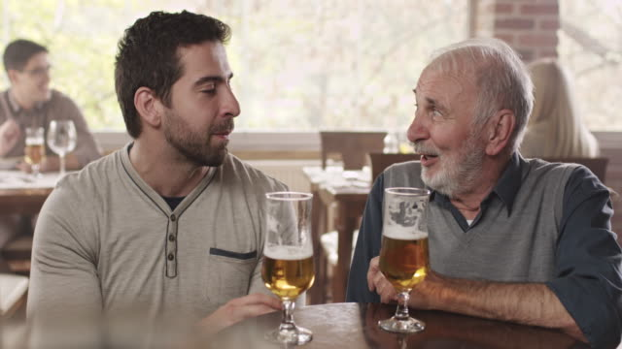
2. How do you characterize the target market segment(s) of Drinkworks? What is its potential target market size?
Consumer Segments:
Socio-Demographic:
Target different age groups, genders, income level
Lager demand and need for hosting/attending parties

Slide 7
2. How do you characterize the target market segment(s) of Drinkworks? What is its potential target market size?
Consumer Segments:
Key segments to Target:
Weekly Drinkers and hosts of the Younger Demographic
Weekly Drinkers and hosts of the Older Demographic
Monthly Drinkers and hosts
Key challenges in reaching these targets:
Developing Product Awareness
Information advertisements necessary to demonstrate usage
Various media will need to be used to reach target segments that span a variety of generations(social media, Tv ads and more)
Convincing consumers of high quality will be key to capturing these segments
Notes:
For weekly drinkers and hosts (young’s)
- Key need: Affordable and variety of beverages for both hosting and drinking alone
Drinkworks Solution
- Variety of beverages for guests in a more affordable and convenient way than competition offers
- Removes all intimidation of mixing drinks to offer a more enjoyable hosting experience
For weekly drinkers and hosts (older)
- Key need: Variety and convenience for hosting guests
Drinkworks Solution
- Improved variety of beverages available, at a relative low cost
- Improved convenience in preparing numerous drinks for various people
Monthly Drinkers and Hosts
- Key need: Ability to offer high quality drinks to guests when occasion arises
Drinkworks Solution
- Offer high quality combined with variety and convenience
- Allows hosts to offer top quality drinks while simultaneously improving the hosting experience
Key challenges in reaching these targets
- Developing Product awareness
- Information advertisements necessary to demonstrate usage
- Various media will need to be used to reach target segments that span a variety of generations
- Convincing consumers of high quality will be key to capturing these segments

Slide 8
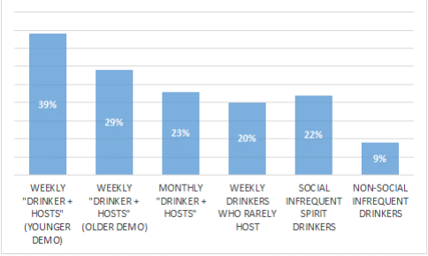
2. How do you characterize the target market segment(s) of Drinkworks? What is its potential target market size?
Potential market size:
-Initial appeal among consumers;
-9% to 39% survey responses interested in purchasing the machine and pods;
- Average Alcohol Consumption, 19.4L for men e 7L for women;
Notes:
Most of consumers were either unsure how to make a cocktail or intimidated by the idea of making themselves.
Initially the idea of cocktail-making device had a significant appeal among consumers.
9 to 39% survey responses interested in purchasing the machine and pods
But actually between 39 and 23% of the 1800 are the part of the 3 key segments

Slide 9
3. What is Drinkworks value proposition in the market?
Drinkworks could be perceived as an innovative product since it is a modern and cutting-edge approach. The device simplifies, speeds up, and improves cocktail-making efficiency, making the product more convenient for the customers. The product is sophisticated and seems to be luxurious.
Therefore, the value proposition that distinguishes Drinkworks from other players in the market can be:
Drinkworks is an innovative product in which you can make high-quality cocktails at home comfort from a pod with the convenience of the distance of a touch of a button.
Notes:
Drinkworks could be perceived as an innovative product since it is a modern and cutting-edge approach. The device simplifies, speeds up, and improves cocktail-making efficiency, making the product more convenient for the customers. The product is sophisticated and seems to be luxurious. Therefore, the value proposition that distinguishes Drinkworks from other players in the market can be:
Drinkworks is an innovative product in which you can make high-quality cocktails at home comfort from a pod with the convenience of the distance of a touch of a button.
The positioning of Drinkworks in the market can be:
Drinkworks provides an excellent solution for making cocktails without getting out of home by offering a machine that could produce various high-quality leverages from pods at the touch of a button. It is a practical solution for those who want to drink alone or with friends in their own home without losing the quality of the leverages or spending time experimenting and testing recipes. That product provides a worry-free mind. It sparks good times, creates memories, and generates an atmosphere of happiness.
There are some advantages and disadvantages to selling pods with or without alcohol.
Mixer pods without alcohol would contain all the ingredients necessary for a particular cocktail, and users would add their alcohol to it.
Therefore, the mixer pod's advantages are:
cheaper
might avoid regulatory problems for distribution
more accessible for consumers to comprehend
consumers can add their preferred alcohol brand and the desired amount
And the disadvantages of the mixer pods are:
it’s not so practical for the consumers who don’t care about the alcoholic brand
On the other hand, the alcoholic pods present the pros and cons below.
Alcoholic pod's disadvantages:
difficulty to the customer to understand how could fit a whole drink in the pod
face distribution hurdles
consumers can't add their preferred alcohol brand or the desired amount
Alcoholic pod's advantages:
ease and convenience of making a cocktail at the touch of a button
Despite mixer pods presenting many advantages, we believe that Drinkworks should introduce alcoholic pods since we think this is the innovative key to that product, have cocktails at a distance of a button.
To contour the disadvantages of the alcoholic pods is essential to advertise and clarify to customers about the product and sell the pods in liquor stores. The machines should be sold online and in retail stores.

Slide 10
3. What is Drinkworks positioning in the market?
The positioning of Drinkworks in the market can be:
Drinkworks provides an excellent solution for making cocktails without getting out of home by offering a machine that could produce various high-quality leverages from pods at the touch of a button. It is a practical solution for those who want to drink alone or with friends in their own home without losing the quality of the beverages or spending time experimenting and testing recipes. That product provides a worry-free mind. It sparks good times, creates memories, and generates an atmosphere of happiness.
Notes:
Drinkworks could be perceived as an innovative product since it is a modern and cutting-edge approach. The device simplifies, speeds up, and improves cocktail-making efficiency, making the product more convenient for the customers. The product is sophisticated and seems to be luxurious. Therefore, the value proposition that distinguishes Drinkworks from other players in the market can be:
Drinkworks is an innovative product in which you can make high-quality cocktails at home comfort from a pod with the convenience of the distance of a touch of a button.
The positioning of Drinkworks in the market can be:
Drinkworks provides an excellent solution for making cocktails without getting out of home by offering a machine that could produce various high-quality leverages from pods at the touch of a button. It is a practical solution for those who want to drink alone or with friends in their own home without losing the quality of the leverages or spending time experimenting and testing recipes. That product provides a worry-free mind. It sparks good times, creates memories, and generates an atmosphere of happiness.
There are some advantages and disadvantages to selling pods with or without alcohol.
Mixer pods without alcohol would contain all the ingredients necessary for a particular cocktail, and users would add their alcohol to it.
Therefore, the mixer pod's advantages are:
cheaper
might avoid regulatory problems for distribution
more accessible for consumers to comprehend
consumers can add their preferred alcohol brand and the desired amount
And the disadvantages of the mixer pods are:
it’s not so practical for the consumers who don’t care about the alcoholic brand
On the other hand, the alcoholic pods present the pros and cons below.
Alcoholic pod's disadvantages:
difficulty to the customer to understand how could fit a whole drink in the pod
face distribution hurdles
consumers can't add their preferred alcohol brand or the desired amount
Alcoholic pod's advantages:
ease and convenience of making a cocktail at the touch of a button
Despite mixer pods presenting many advantages, we believe that Drinkworks should introduce alcoholic pods since we think this is the innovative key to that product, have cocktails at a distance of a button.
To contour the disadvantages of the alcoholic pods is essential to advertise and clarify to customers about the product and sell the pods in liquor stores. The machines should be sold online and in retail stores.

Slide 11
3. What Pods should be introduced?
Alcoholic pod's
Advantages:
ease and convenience of making a cocktail at the touch of a button
Disadvantages:
difficulty to the customer to understand how could fit a whole drink in the pod
face distribution hurdles
consumers can't add their preferred alcohol brand or the desired amount
Mixer pod's
Advantages:
consumers can add their preferred alcohol brand and the desired amount
cheaper
might avoid regulatory problems for distribution
more accessible for consumers to comprehend
Disadvantages:
it's not so practical for the consumers who don't care about the alcoholic brand
Notes:
Drinkworks could be perceived as an innovative product since it is a modern and cutting-edge approach. The device simplifies, speeds up, and improves cocktail-making efficiency, making the product more convenient for the customers. The product is sophisticated and seems to be luxurious. Therefore, the value proposition that distinguishes Drinkworks from other players in the market can be:
Drinkworks is an innovative product in which you can make high-quality cocktails at home comfort from a pod with the convenience of the distance of a touch of a button.
The positioning of Drinkworks in the market can be:
Drinkworks provides an excellent solution for making cocktails without getting out of home by offering a machine that could produce various high-quality leverages from pods at the touch of a button. It is a practical solution for those who want to drink alone or with friends in their own home without losing the quality of the leverages or spending time experimenting and testing recipes. That product provides a worry-free mind. It sparks good times, creates memories, and generates an atmosphere of happiness.
There are some advantages and disadvantages to selling pods with or without alcohol.
Mixer pods without alcohol would contain all the ingredients necessary for a particular cocktail, and users would add their alcohol to it.
Therefore, the mixer pod's advantages are:
cheaper
might avoid regulatory problems for distribution
more accessible for consumers to comprehend
consumers can add their preferred alcohol brand and the desired amount
And the disadvantages of the mixer pods are:
it’s not so practical for the consumers who don’t care about the alcoholic brand
On the other hand, the alcoholic pods present the pros and cons below.
Alcoholic pod's disadvantages:
difficulty to the customer to understand how could fit a whole drink in the pod
face distribution hurdles
consumers can't add their preferred alcohol brand or the desired amount
Alcoholic pod's advantages:
ease and convenience of making a cocktail at the touch of a button
Despite mixer pods presenting many advantages, we believe that Drinkworks should introduce alcoholic pods since we think this is the innovative key to that product, have cocktails at a distance of a button.
To contour the disadvantages of the alcoholic pods is essential to advertise and clarify to customers about the product and sell the pods in liquor stores. The machines should be sold online and in retail stores.

Slide 12
3. What Pods should be introduced?
Despite mixer pods presenting many advantages, we believe that Drinkworks should introduce alcoholic pods since we think this is the innovative key to that product, have cocktails at a distance of a button.
To contour the disadvantages of the alcoholic pods is essential to advertise and clarify to the customers about the product and sell the pods in liquor stores. The machines should be sold online and in retail stores.
Notes:
Drinkworks could be perceived as an innovative product since it is a modern and cutting-edge approach. The device simplifies, speeds up, and improves cocktail-making efficiency, making the product more convenient for the customers. The product is sophisticated and seems to be luxurious. Therefore, the value proposition that distinguishes Drinkworks from other players in the market can be:
Drinkworks is an innovative product in which you can make high-quality cocktails at home comfort from a pod with the convenience of the distance of a touch of a button.
The positioning of Drinkworks in the market can be:
Drinkworks provides an excellent solution for making cocktails without getting out of home by offering a machine that could produce various high-quality leverages from pods at the touch of a button. It is a practical solution for those who want to drink alone or with friends in their own home without losing the quality of the leverages or spending time experimenting and testing recipes. That product provides a worry-free mind. It sparks good times, creates memories, and generates an atmosphere of happiness.
There are some advantages and disadvantages to selling pods with or without alcohol.
Mixer pods without alcohol would contain all the ingredients necessary for a particular cocktail, and users would add their alcohol to it.
Therefore, the mixer pod's advantages are:
cheaper
might avoid regulatory problems for distribution
more accessible for consumers to comprehend
consumers can add their preferred alcohol brand and the desired amount
And the disadvantages of the mixer pods are:
it’s not so practical for the consumers who don’t care about the alcoholic brand
On the other hand, the alcoholic pods present the pros and cons below.
Alcoholic pod's disadvantages:
difficulty to the customer to understand how could fit a whole drink in the pod
face distribution hurdles
consumers can't add their preferred alcohol brand or the desired amount
Alcoholic pod's advantages:
ease and convenience of making a cocktail at the touch of a button
Despite mixer pods presenting many advantages, we believe that Drinkworks should introduce alcoholic pods since we think this is the innovative key to that product, have cocktails at a distance of a button.
To contour the disadvantages of the alcoholic pods is essential to advertise and clarify to customers about the product and sell the pods in liquor stores. The machines should be sold online and in retail stores.

Slide 13
4. How should the device and pods be priced?
“The respondents who were willing to pay at least $299 were more likely to be between the ages of 21 and 29, live in an urban area, socialize at home at least once a week, and have higher household income levels”
“Generally, those who indicated higher willingness to pay for the device also tended to project slightly higher device usage”
In other words, the target market segment was likely to be willing to pay at least 299$. Coincidently, this higher willingness to pay for the product was accompanied by an intended more frequent device usage.
Notes:
42% of the respondents were not interested
New concept with limited competition therefore value-based pricing should be the best approach to find ideal pricing.

Slide 14
4. How should the device and pods be priced?
Because this is a novel product with limited competition, the prices should be chosen in order to maximise the value.
With the quotes on the last slide in mind the strategy to choose the prices should follow this logic:
For the appliance, because this is a one-time-purchase, maximise the number of individuals it reaches while maintaining positive profit.
Reaching more customers means selling more pods, which is a recurring purchase. This allows for higher profit in the long run.
Maximise profit on the pods.
Later, if there appear new and defying competitors, adjust the prices.

Slide 15
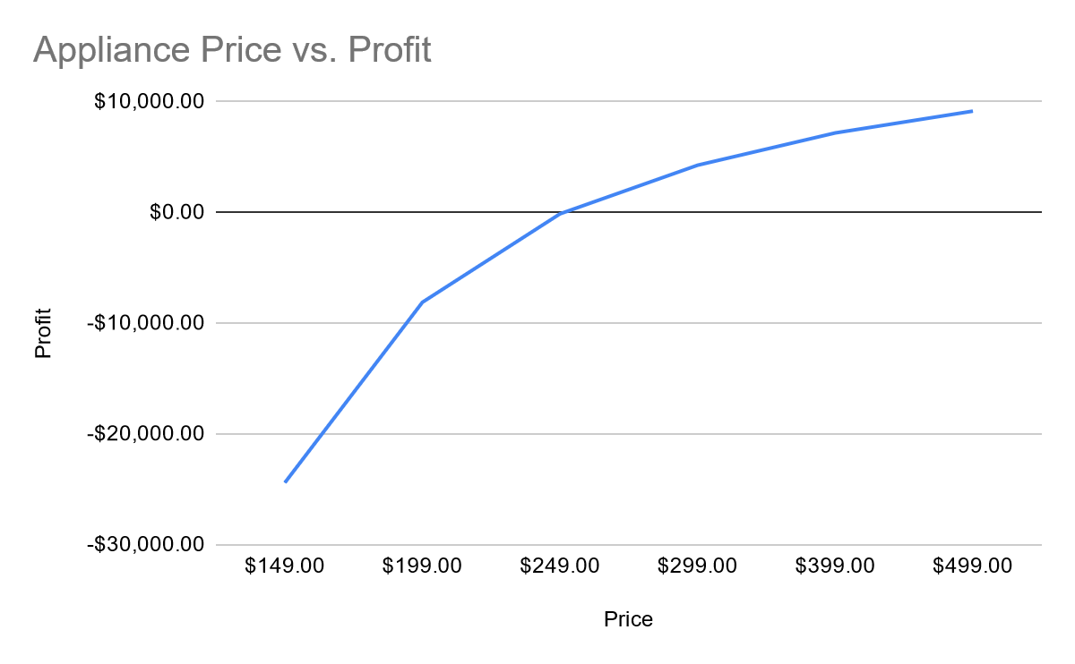
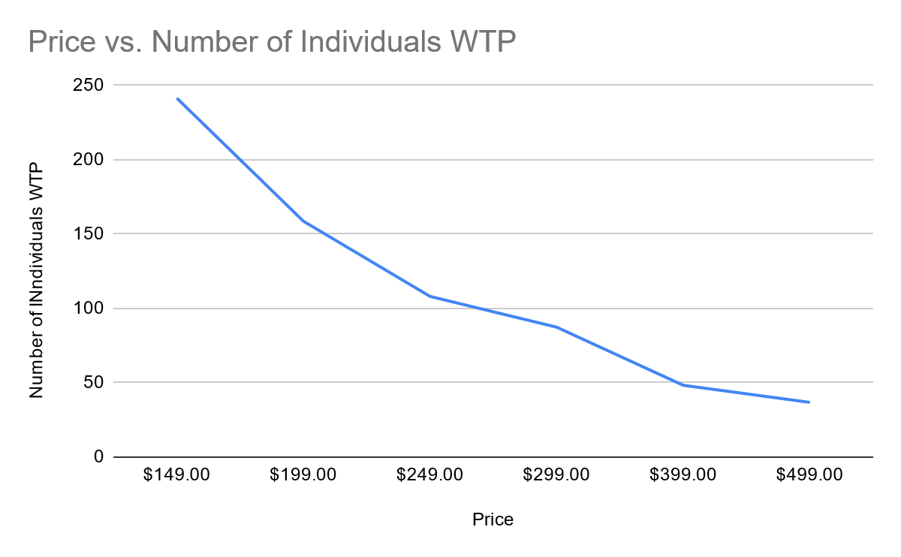
4. How should the device and pods be priced?
Ideal price would be $299.00
Reasons:
Reaches one of the main target market segments
Reaches the most number of individuals while maintaining positive profit (production costs $250)
If the company is able, there is an argument to be made in sustaining losses while selling the appliance so it reaches more customers. The company can plan to recover those losses with the pods.
Notes:
Each Drinkworks Home Bar would cost approximately $250.
According to our strategy, the appliance should be sold in a way not to maximise profit but to maximise the number of customers reached.
The ideal price we chose would then be $299.00 because between all prices that do not require losses selling the appliance, it is the one to reach more clients.
With the $299.00 one of the target market segments is reached, that being young adults who live in an urban area, socialize at home at least once a week, and have higher household income levels.

Slide 16
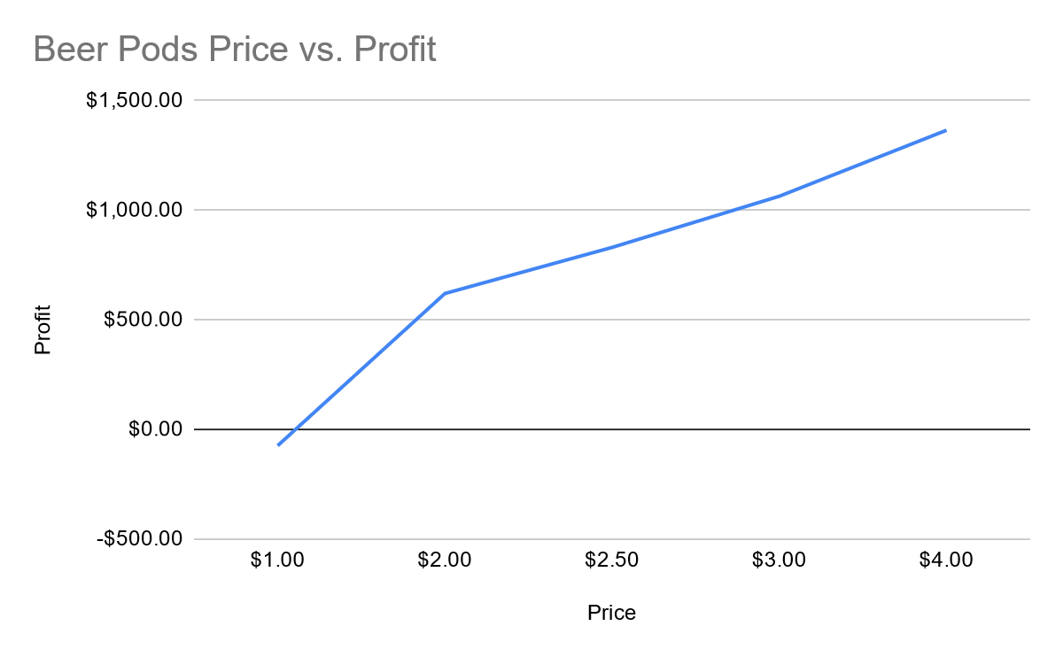
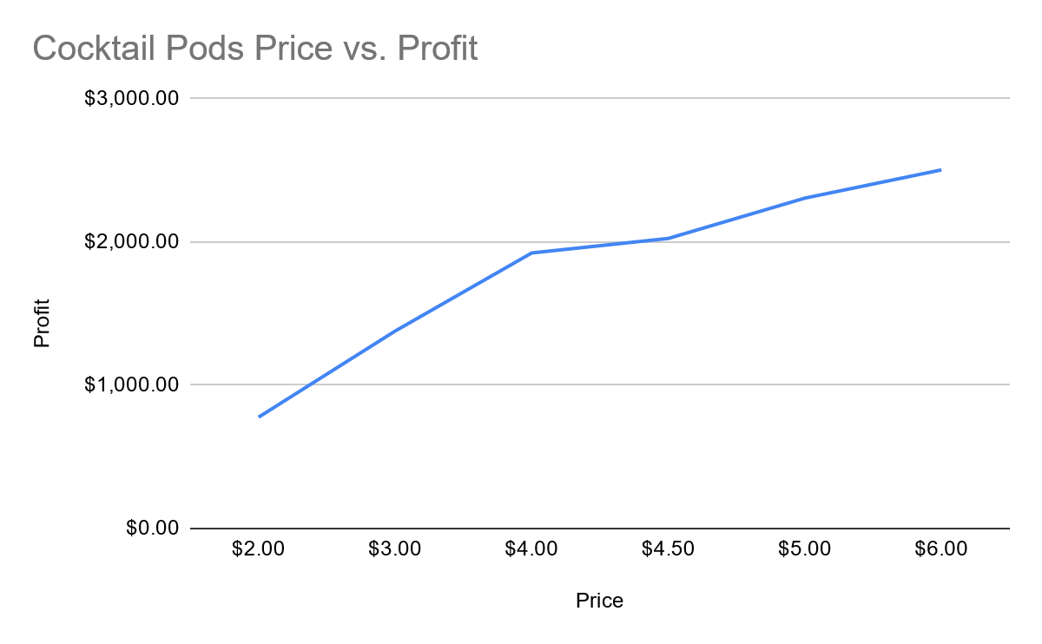
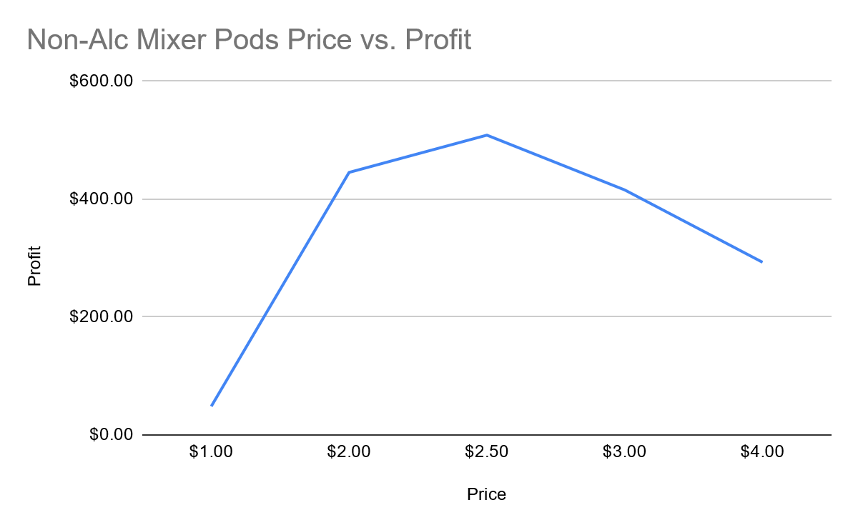
4. How should the device and pods be priced?
Pod Price Strategy - maximise profit
Ideal Price: $4.00
Ideal Price: $6.00
Ideal Price: $2.50
Notes:
According to our chosen strategy, Drinkworks should maximise profit on the pods.
Based on the experiments conducted by Drinkworks on willingness to pay in 2017 we calculated estimated profit values for each pod pricing.
With the results, the prices that maximise profit for beer pods, cocktail pods and non alcoholic mixer pods are 4.00$, 6.00$ and 2.50, respectively.
(cocktail pods, non-alcoholic mixer pods, and beer pods were $1.20, $0.95, and $1.10, respectively)

Slide 17
5. SWOT analysis
STRENGTHS
Innovative product;
Sophisticated and fancy product;
A convenient product that makes cocktail preparation more efficient(fast and simpler)
Large pods offer;
Advanced technology;
It brings joy and a relaxing sensation to the customer;
WEAKNESSES
It is necessary to replace the water filter and the CO2 canister regularly;
It takes 10 minutes to chill the water;
Expensive machine;
Very specific target audience;
OPPORTUNITIES
Few competition;
Keurig is already on the beverage machines market, so it’s easy for them to introduce this product;
THREATS
The difficulty of selling alcoholic pods between US states;
Drinkworks and AB InBev had little experience in e-commerce, which is the most used trade system for young people, the target audience.
Notes:
In order to make a decision either if DrinkWorks will be successfully or not, the group made a SWOT analyses to put advantages and disadvantages of this product in perspective.

Slide 18
5. What are the risk opportunities, and what would you recommend Keurig to do to address them?
1.
Very specific target audience and relatively small
Market Campaigns focused on the target audience (young adults who like to drink and host parties)
Customer-proximity system
Automation of the system (technologies investment)
2.
Few competitors
Attract the target public to buy DrinkWorks product
Prices can be managed
3.
Sell of alcoholic pods
Also invest and bet on mixer pods
Make partnerships with famous beverage brands
Invest in a strong promotional campaign
Invest in pods offer
Notes:
The main risk opportunity identified is the target audience which is very specific and relatively small since DrinkWorks is a luxury product and dispensable. With that in mind, Keuring should invest in marketing campaigns for the target audience and a customer-proximity system. Invest in automation of the system(investing in technologies → automatic help, fast responses, easy and simplistic buying).
Another risk opportunity is that are few competitors. That can mean that this product is very innovative or isn't a smart invention since only a few people are interested in this. Maybe, initially public will be curious about that, but if there is no further innovation, the product's success could end. The fact that there is almost no competition can also be an advantage because what Keurig is creating will be news, and people who are interested in the product will be more likely to buy from them. Also, with almost no competition, the company can manage better the prices.
The main risk we analysed was the selling of alcoholic pods. Due to legislation about alcoholic drinks, we think the smart move is to sell only mixer pods. With these pods, the clients will be able to add an alcoholic drink of a brand of their choice to have a better experience. Another opportunity we identify is the possibility of making partnerships (not selling alcoholic beverages but motivating people to buy a specific brand so that the brand can help DrinkWorks monetarily). The company can also think of different promotional campaigns for various states. According to the legislation, Keurig can partner with alcoholic beverage brands to sell packs locally.

Slide 19
5. Will Drinkworks be the next billion-dollar opportunity of Keurig and AB InBev?
We don’t think DrinkWorks will be the next billion-dollar opportunity because
Most of the audience was not willing to pay the fixed value for the machine;
We consider it an innovative product but think the machine itself doesn’t need many improvements;
It’s not an essential product;
Product for a very specific public.
Although, the group came up with an idea for the product succeed (based on the printers market):
Lower the production cost so the machine price can be lower too;
Sell the machine at production cost;
Investing in the pods’ variety, increasing their price.
Notes:
Although it was made a large exploration of the product and explored the type of people interested in that product and how much they are willing to pay, most of the audience was not willing to pay the fixed value for the machine.
So, to conclude, we don’t think DrinkWorks will be the next billion-dollar opportunity. Although it’s an innovative product but the machine itself doesn’t need many improvements. We thought about a new version machine that Drinkworks could launch in the future to replace the necessity to change the CO2 canister regularly and to chill the water faster than 10 minutes. However, we are unsure if this new version will sell because we don’t believe clients would substitute the older machine with these improvements. We are not sure about attracting new clients, and we think that the public interest in this product will not increase in a short period. One possibility we thought DrinkWorks could have success was to lower the production costs to sell the machine cheaper and expect the profit to come from pods selling, innovating on the drinks possibilities and investing in variety.
Nonetheless, we think this product has many risks involved, and since it’s not an essential product, our opinion is that it will have success at the start, but then the sellings will slow down. Also, it’s a product for a very specific client, young adults who drink alcohol and who usually host people at their homes with a good annual yield.

